Slide 1
HFWE High Frequency Word Evaluation Admin
Admin Window Teachers All Students Reports
Word Lists HISD
Word Lists
Grade Level | School Year | Language | Name
1 | 2018 | English | 2018_G1_E | Edit
2 | 2018 | English | 2018_G2_E | Edit
1 | 2018 | Spanish | 2018_G1_S | Edit
2 | 2018 | Spanish | 2018_G2_S | Edit
1 | 2018 | English | 2018_G1_E1 | Edit
2 | 2018 | English | 2018_G2_E1 | Edit
1 | 2018 | Spanish | 2018_G1_S1 | Edit
2 | 2018 | Spanish | 2018_G2_S2 | Edit

Slide 2
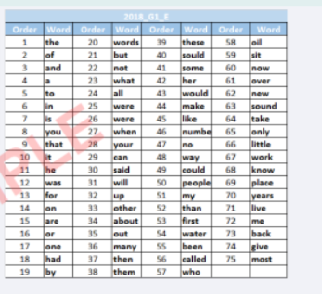
HFWE High Frequency Word Evaluation Admin
Admin Window Teachers All Students Reports
Words List HISD
Word Lists
Ok

Slide 3
HFWE High Frequency Word Evaluation Admin
Admin Window Teachers All Students Reports
Word List HISD
Word Lists
Word List Creation
School Year : 2018 List Name: Grade Level : Language :
Created on save
Order | Word
1 | And | Edit
2 | If | Edit
3 | Or | Edit
4 | We | Edit
Cancel
Save

Slide 4
HFWE High Frequency Word Evaluation Admin
Words List Teachers All Students Reports
Administration Window(s) HISD
Admin Window
School Year | Name | Start Date | End Date | Grade Level | English List | Spanish List | Status
2018 | First | 9/4/2017 | 9/15/2017 | 1 | 2018_G1_E | 2018_G1_S | Active | Edit
2018 | Second | 11/13/2017 | 11/24/2017 | 2 | 2018_G2_E | 2018_G2_S | Not Active | Edit
2018 | Third | 1/15/2018 | 1/26/2018 | 2 | 2018_G2_E1 | 2018_G2_S1 | Not Active | Edit
2018 | Summer | 4/16/2018 | 4/27/2018 | 1 | 2018_G1_E1 | 2018_G1_S1 | Not Active | Edit

Slide 5
HFWE High Frequency Word Evaluation Admin
Word Lists Admin Window Teachers All Students Reports
Administration Window HISD
Admin Window
Ok

Slide 6
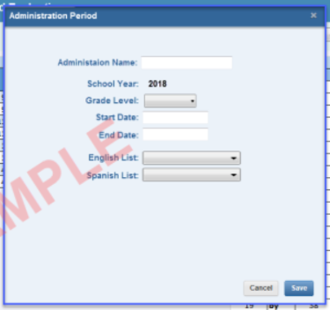
HFWE High Frequency Word Evaluation Admin
Words List Teachers All Students Reports
Administration Period Creation HISD
Admin Window

Slide 7
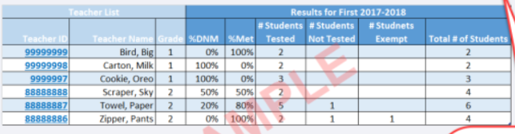
HFWE High Frequency Word Evaluation Admin
Words List Admin Window All Students Reports
Teachers List HISD
Teachers

Slide 8
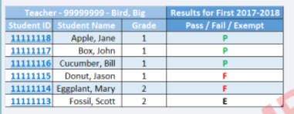
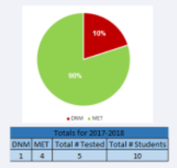
HFWE High Frequency Word Evaluation Admin
Words List Admin Window All Students Reports
Teacher List- Student Summary HISD
Teachers

Slide 9
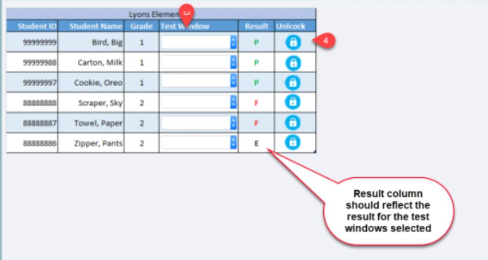
HFWE High Frequency Word Evaluation Admin
Words List Admin Window Teachers Reports
Students List HISD
All Students

Slide 10
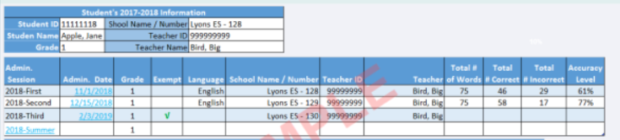

HFWE High Frequency Word Evaluation Admin
Words List Admin Window Teachers Reports
Student Summary HISD
All Students

Slide 11

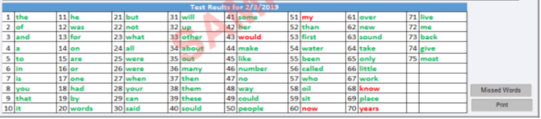
HFWE High Frequency Word Evaluation Admin
HFWE High Frequency Word Evaluation Admin
Words List Test Window Teachers List Students List Reports
Student List HISD
Words List Admin Window Teachers Reports
Student Result HISD
Students
Ok

Slide 12
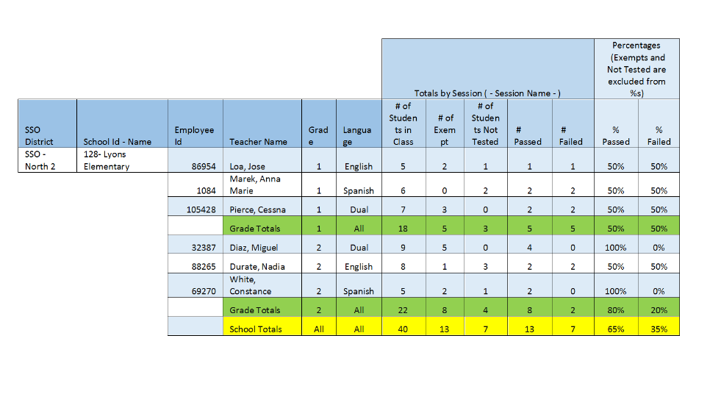
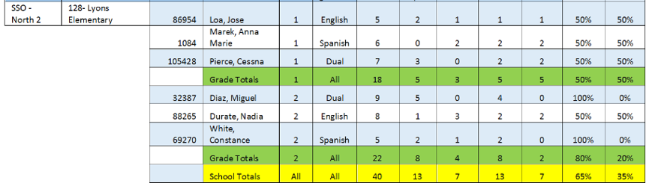
HFWE High Frequency Word Evaluation Admin
Words List Admin Window Teachers Students
School Report Officer: Campus: HISD
Reports
School Report
SSO-North 3
203- Mading Elementary

Slide 13
HFWE High Frequency Word Evaluation Admin
Words List Admin Window Teachers Students
School Report Officer: Campus: HISD
Reports
School Report

Slide 14
HFWE High Frequency Word Evaluation SSO
Reports
Reports Officer: Campus: HISD
SSO – North 2

Slide 15
HFWE High Frequency Word Evaluation Cecilia Gonzales(Principal)
Students Reports
Teachers
Teachers List HISD
Northside High School

Slide 16
HFWE High Frequency Word Evaluation Cecilia Gonzales(Principal)
Students Reports
Teacher – Bird, Big HISD
Teachers
Northside High School
Go back to Teachers List

Slide 17
HFWE High Frequency Word Evaluation Cecilia Gonzales(Principal)
Teachers Reports
Students List HISD
Northside High School
Students

Slide 18
HFWE High Frequency Word Evaluation Cecilia Gonzales(Principal)
Teachers Reports
Student Summary HISD
Northside High School
Students
Northside HS - 003

Slide 19
HFWE High Frequency Word Evaluation Cecilia Gonzales(Principal)
Teachers Reports
Student Result HISD
Northside High School
Students
Ok

Slide 20
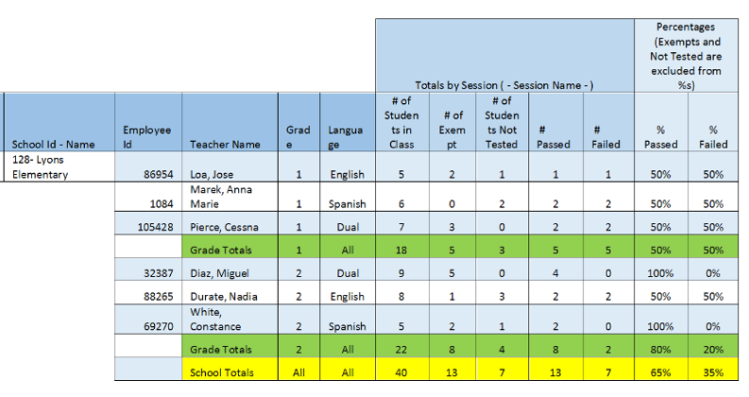
HFWE High Frequency Word Evaluation Cecilia Gonzales(Principal)
Teachers Students
School Report HISD
Northside High School
Reports
School Report
003-Northside High School

Slide 21
HFWE High Frequency Word Evaluation School Coordinator
Teachers
Students Reports
Teachers List HISD
Northside High School

Slide 22
HFWE High Frequency Word Evaluation School Coordinator
Teachers
Students Reports
Teacher List HISD
Northside High School

Slide 23
HFWE High Frequency Word Evaluation School Coordinator
Teachers Reports
Students List HISD
Northside High School
Students

Slide 24
HFWE High Frequency Word Evaluation School Coordinator
Teachers Reports
Student Summary HISD
Northside High School
Students
Northside HS - 003

Slide 25
HFWE High Frequency Word Evaluation School Coordinator
Teachers Reports
Student Result HISD
Northside High School
Students
Ok

Slide 26
HFWE High Frequency Word Evaluation School Coordinator
Teachers Students
School Report HISD
Northside High School
Reports
School Report
003-Northside High School

Slide 27
HFWE High Frequency Word Evaluation Cessna Pierce(Teacher)
Students
Test Window Reports
Students List HISD
Lyons Elementary

Slide 28
HFWE High Frequency Word Evaluation Cessna Pierce(Teacher)
Students
Test Window Reports
Student Summary HISD
Lyons Elementary

Slide 29
HFWE High Frequency Word Evaluation Cessna Pierce(Teacher)
Students
Test Window Reports
Student Result HISD
Lyons Elementary
Ok

Slide 30
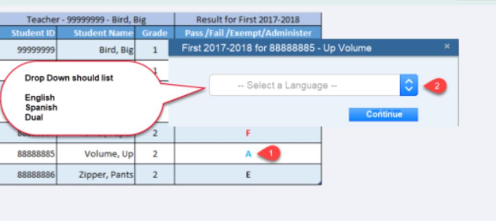
HFWE High Frequency Word Evaluation Cessna Pierce(Teacher)
Students Reports
Test Window HISD
Lyons Elementary
Test Window

Slide 31
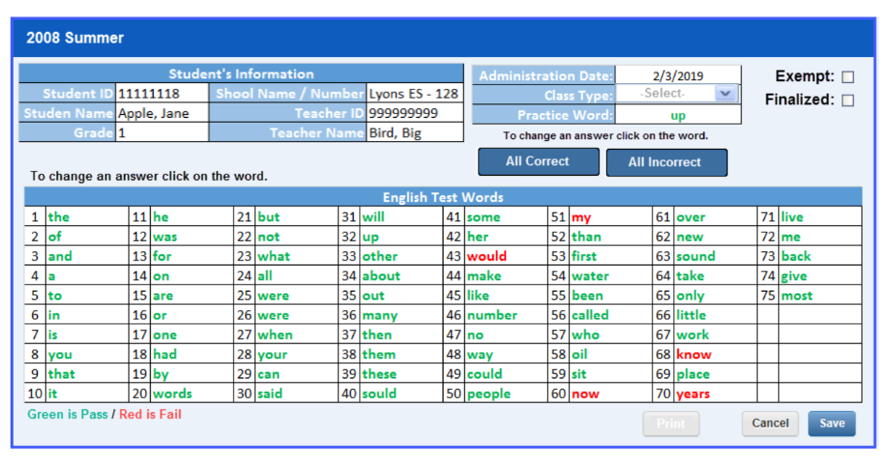
HFWE High Frequency Word Evaluation Cessna Pierce(Teacher)
Students Reports
Test Window HISD
Lyons Elementary
Test Window
2018 - Summer

Slide 32
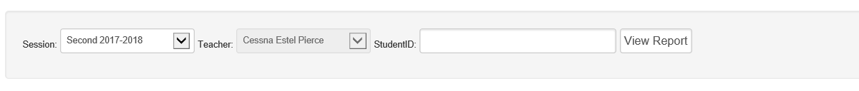
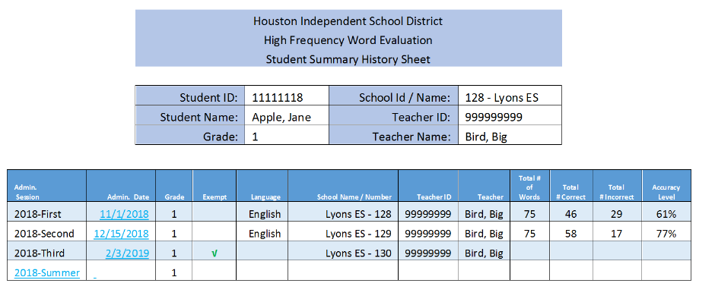
HFWE High Frequency Word Evaluation Cessna Pierce(Teacher)
HFWE High Frequency Word Evaluation Cessna Pierce(Teacher)
Students Test Window
Students Test Window Reports
Student Summary Report HISD
Reports HISD
Lyons Elementary
Lyons Elementary
All
Reports
Student Summary Report
Student Missed
Words Report
School Missed
Words Report
All
Cessna Pierce
Cessna Pierce
Cessna Pierce
Cessna Pierce

Slide 33
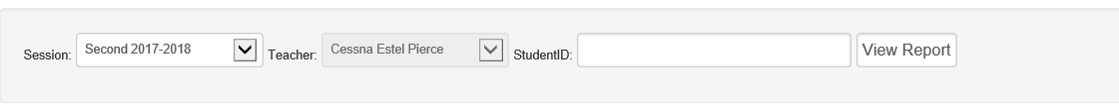
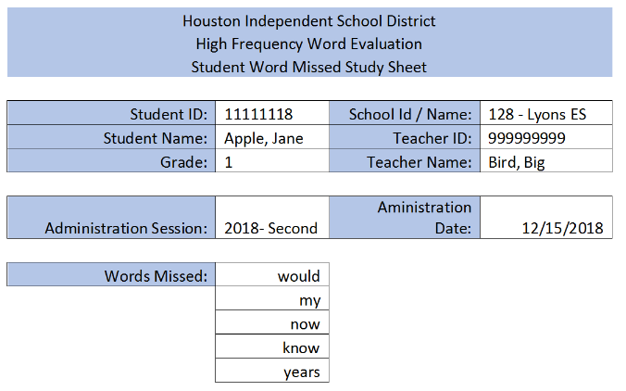
HFWE High Frequency Word Evaluation Cessna Pierce(Teacher)
HFWE High Frequency Word Evaluation Cessna Pierce(Teacher)
Student Missed Words Report HISD
Students Test Window
Reports HISD
Lyons Elementary
Lyons Elementary
Reports
Student Summary Report
Student Missed
Words Report
School Missed
Words Report
111111118
Cessna Pierce

Slide 34
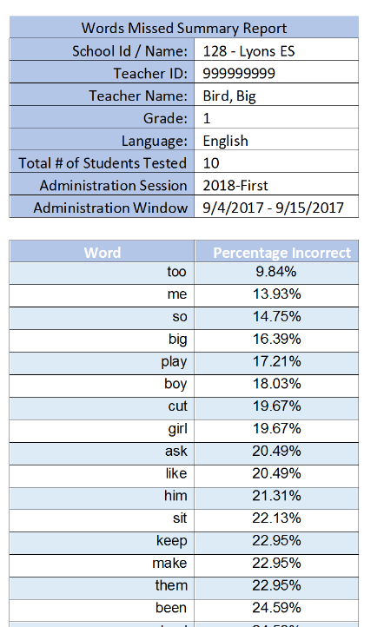
HFWE High Frequency Word Evaluation Cessna Pierce(Teacher)
Students Test Window
School Missed Words Report HISD
Lyons Elementary
Reports
Student Summary Report
Student Missed
Words Report
School Missed
Words Report
Cessna Pierce

